Slide 1

Data Types, Data Structures
4-8 November 2024, ESAC, Spain

Slide 2
Take home message
PDS4 has 4 base classes / data structures
Array
Table
Parsable Byte Stream
Encoded Byte Stream
Some data structures are more used than others !
Binary Array for 2-16 dimensions data sets for image data, data cubes, …
Array_2D_*, Array_3D_*
ASCII Table, binary Table, or Parsable Byte Stream for tabular data
Table_Character, Table_Binary, Table_Delimited
Encoded Byte Stream images for browse products, documents
Encoded_Image, Document

Slide 3
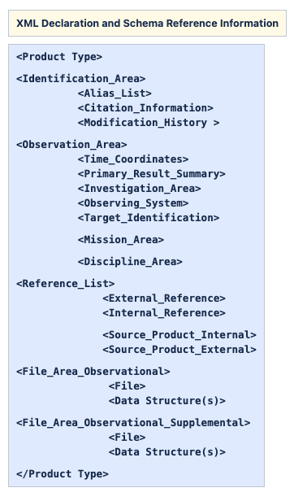
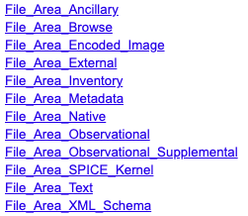
A word on the File Area
Each File_Area has its own flavour of supported
Data Types/Structures
Product structure
Several possible File_Area for a data product
File_Area | Classes supported
Observational | Array, Array_​1D, Array_​2D, Array_​2D_​Image, Array_​2D_​Map, Array_​2D_​Spectrum, Array_​3D, Array_​3D_​Image, Array_​3D_​Movie, Array_​3D_​Spectrum, Encoded_​Audio, Encoded_​Header, Encoded_​Video, Header, Stream_​Text, Table_​Binary, Table_​Character, Table_​Delimited
… | …

Slide 4
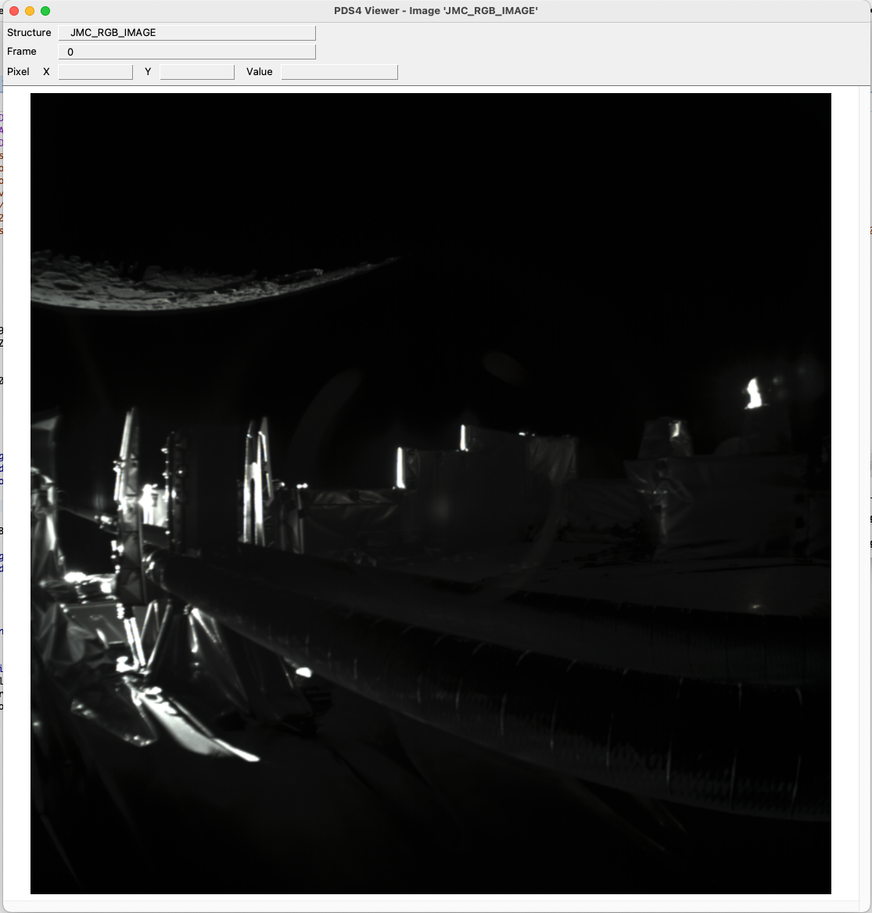
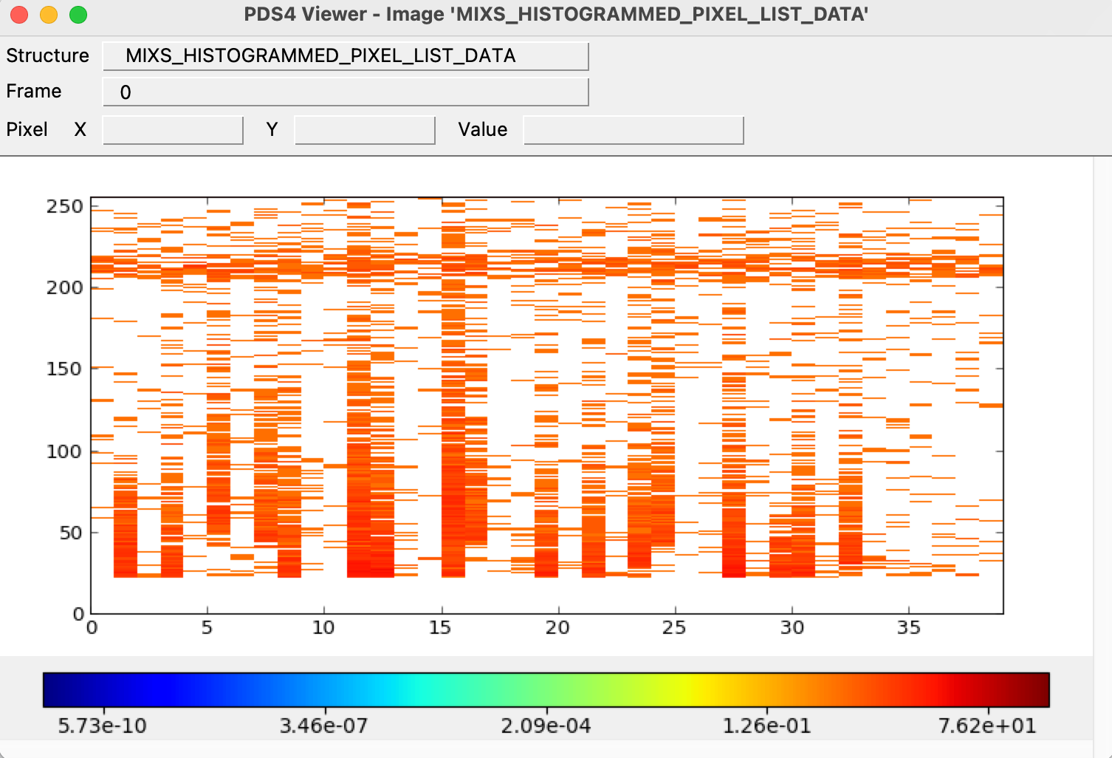
Arrays
Used for homogeneous N-dimensional binary arrays of scalars (elements), up to 16 dimensions.
Sub-class of array exist to better describe the content (Image, Map, Spectrum, Movie)
Axis ordering is tackled by the PDS4 label (Axis_Array): Last Index Fastest (row major).
A RGB image (JUICE/JMC)
Array_3D_Image
Histogram data (Bepi/MIXS)
Array_2D
Dimensions | PDS4 Class
N | Array
1 | Array_1D
2 | Array_2D, Array_2D_Image, Array_2D_Map, Array_2D_Spectrum
3 | Array_3D, Array_3D_Image, Array_3D_Movie, Array_3D_Spectrum
More details in the PDS Standard Reference

Slide 5
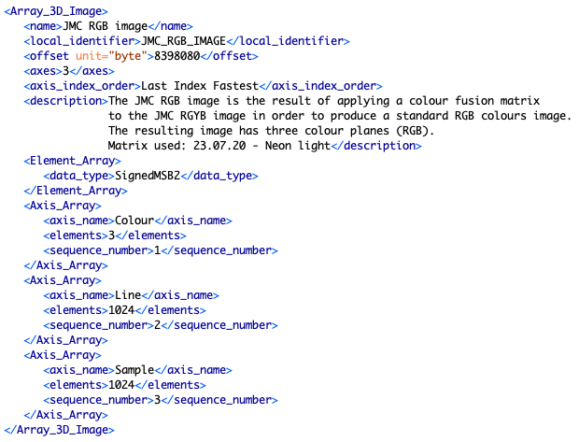
Arrays
Used for homogeneous N-dimensional binary arrays of scalars (elements), up to 16 dimensions.
Sub-class of array exist to better describe the content (Image, Map, Spectrum, Movie)
Axis ordering is tackled by the PDS4 label (Axis_Array): Last Index Fastest (row major).
Dimensions | PDS4 Class
N | Array
1 | Array_1D
2 | Array_2D, Array_2D_Image, Array_2D_Map, Array_2D_Spectrum
3 | Array_3D, Array_3D_Image, Array_3D_Movie, Array_3D_Spectrum
Element_Array
Defines the unique binary data type used in the array
Axis_Array
Defines the axis ordering and number of elements so that the array is row-major.
More details in the PDS Standard Reference

Slide 6
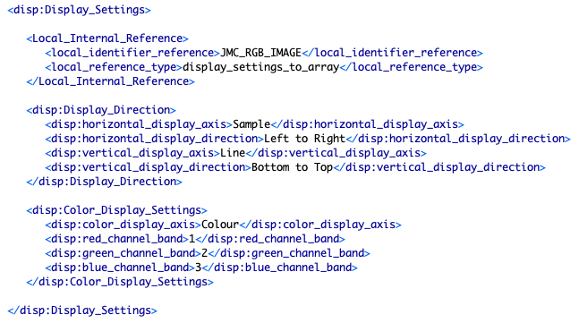
Arrays
Good practice: Define the array display orientation by indicating the Display_Settings of the array
More on this in the Discipline Dictionary presentation
Relates to the display settings
[0,0]
(VICAR,
ISIS)
[0,0]
(FITS)

Slide 7
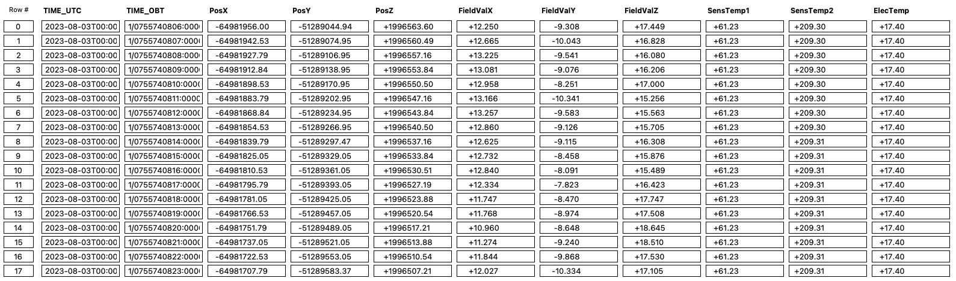
Tables
Tables are made of fixed-length records (=rows) of heterogeneous elements.
Binary tables use Table_Binary ; ASCII or UTF-8 tables use Table_Character.
Records have identical structure and may be terminated by a record delimiter (Table_Character).
Each field (=column) has a single type and length. Field delimiters (e.g. a comma) are optional.
Only 2 dimensional tables are allowed.
Field 1
Field 11
Record 0
Record 17

Slide 8
Tables
When preparing Table_* data products, keep in mind that:
Not all the fields existing in your data may be relevant to archive (e.g. pad bytes, etc.)
If a field always ends up with a unique value in a product (e.g. in a data product where the data are split per observation mode, the mode is usually unique): This is a strong candidate to be moved to the products metadata (in a PDS4 label attribute)
Field 1
Field 11
Record 0
Record 17

Slide 9
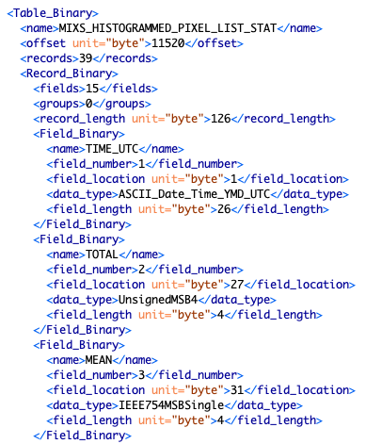
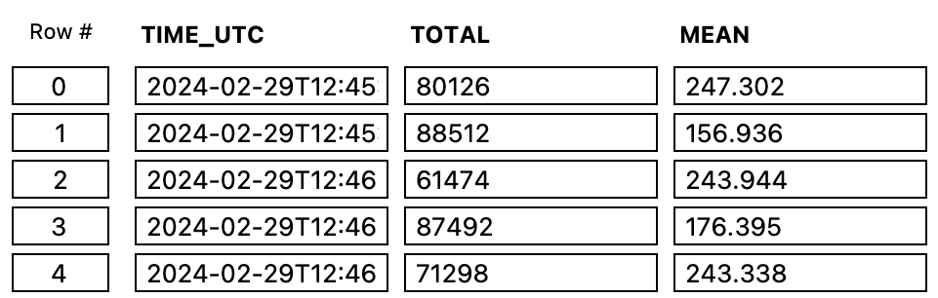
Tables: Table_Binary example
Definition of the Table_Binary
Number of records
Any offset before the start of the table data?
Record_Binary structure
Number of fields per record
Number of groups (if any)
Fixed length of each record
Field_Binary definition
Name
position (field_number and field_location)
data_type (an ASCII data type is fine, e.g. for a datetime)
field_length (+ optional field_format)

Slide 10
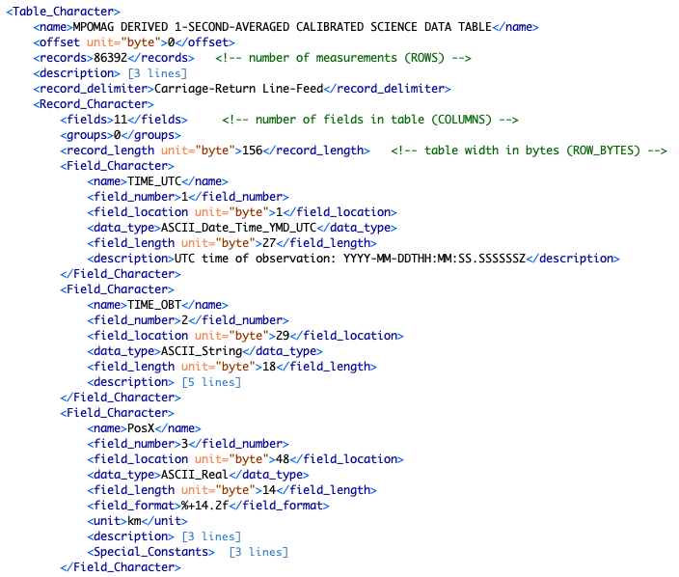
Tables: Table_Character example
Definition of the Table_Character
Number of records
Any offset before the start of the table data?
Record Delimiter (Carriage-Return Line-Feed)
Record_Character structure
Number of fields per record
Number of groups (if any)
Fixed length of each record
Field_Character definition
Name
position (field_number and field_location)
If a field delimiter is used, take it into account for the field_location of the next field
data_type must be an ASCII data type
field_length (+optional field_format)

Slide 11
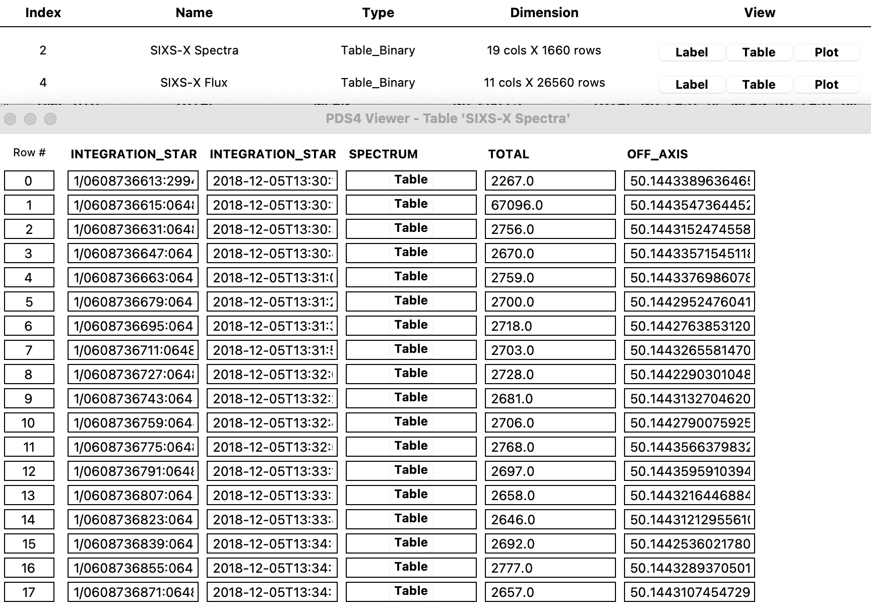
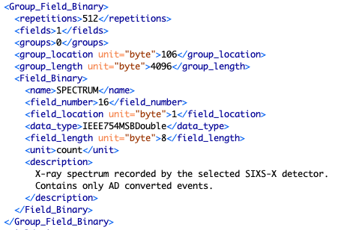
Tables: Use of Group_Fields
In Tables, repeated fields that share a common meaning and definition can be grouped.
Define:
Number of repetitions of the field
Group location and total length
The field definition itself.
SIXS-X binary table including a SPECTRUM Group Field
(ASCII data types)
Spectrum made of 512 values per record (=time)
Reading the full Group_Field (e.g. with PDS4 reader) allows to obtain an “array” of values.

Slide 12
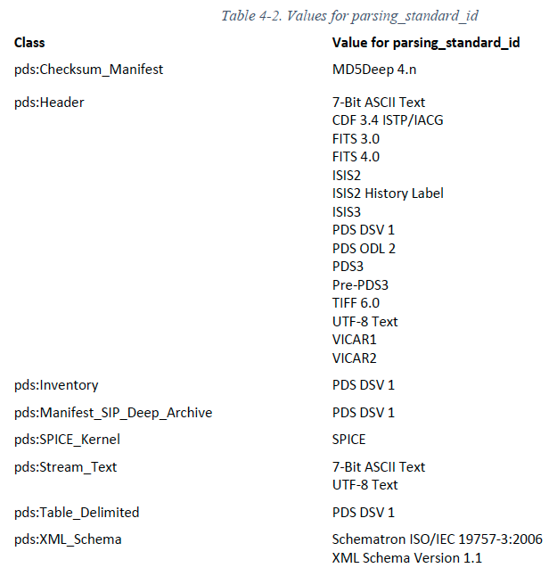
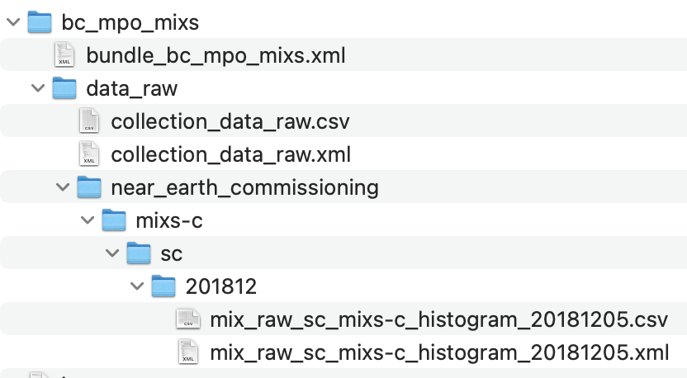
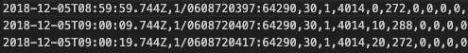
Parsable byte stream
Suitable for plain text, and for tables with variable-length fields and records.
The contents is parsed with standard rules defined by the parsing_standard_id but no decoding software is required.
Basic example: CSV follows “PDS DSV 1” parsing standard.
PDS4 Data Provider’s Handbook

Slide 13
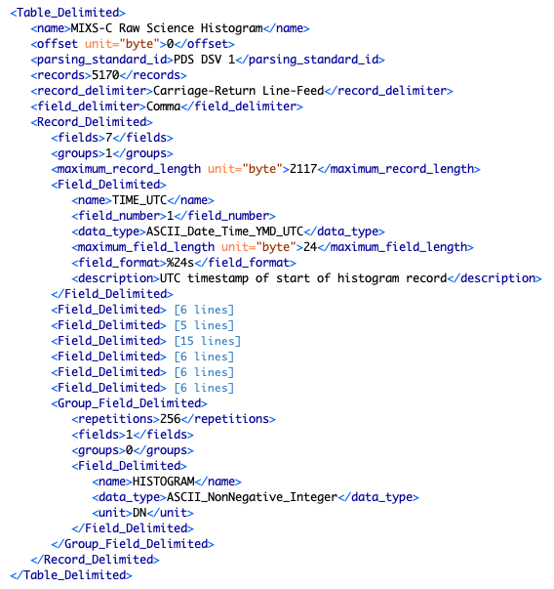
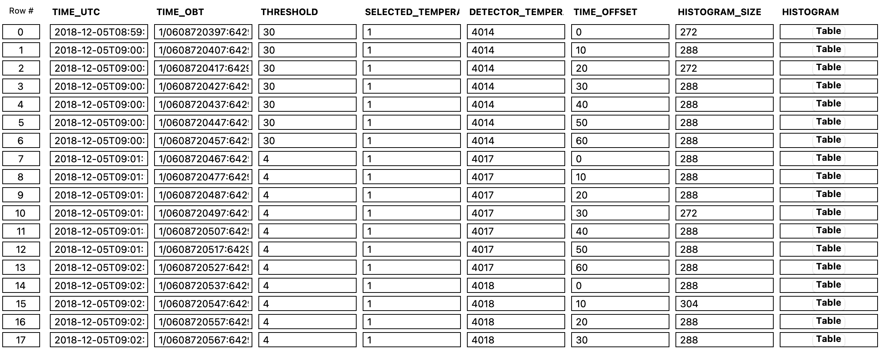
Parsable byte stream: Table_Delimited
record_delimiter (Carriage-Return Line-Feed)
parsing_standard_id (PDS DSV 1)
field_delimiter (comma, horizontal tab, semicolon, vertical bar)
Fields are called Field_Delimited
Group_Field also work with Table_Delimited

Slide 14
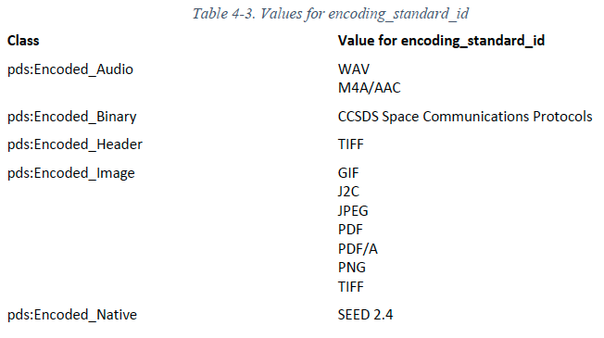
Encoded byte stream
An encoded structure is suitable for complex documents, browse products, etc., but generally not for science data products. The attribute encoding_standard_id must be used.
The use of encoded structure objects is restricted by PDS to a limited set of PDS approved external standards (e.g., PDF/A, JPEG, GIF, …).
Only in exceptional cases will encoded structure objects be considered appropriate for storing observational – that is, science – data. Check with your Archive Scientist.
PDS4 Data Provider’s Handbook

Slide 15
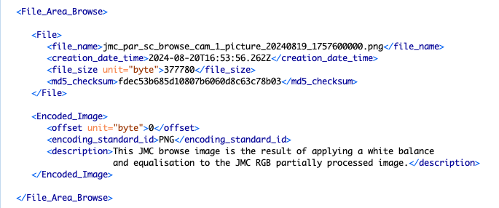
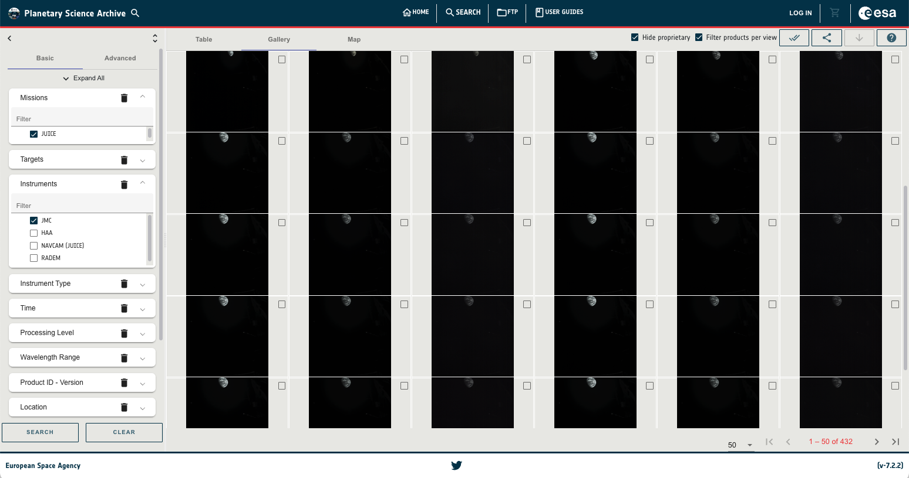
Encoded byte stream: Product_Browse example
The encoded structure is used in the browse products displayed in the PSA image gallery (Encoded_Image, e.g. PNG images)

Slide 16
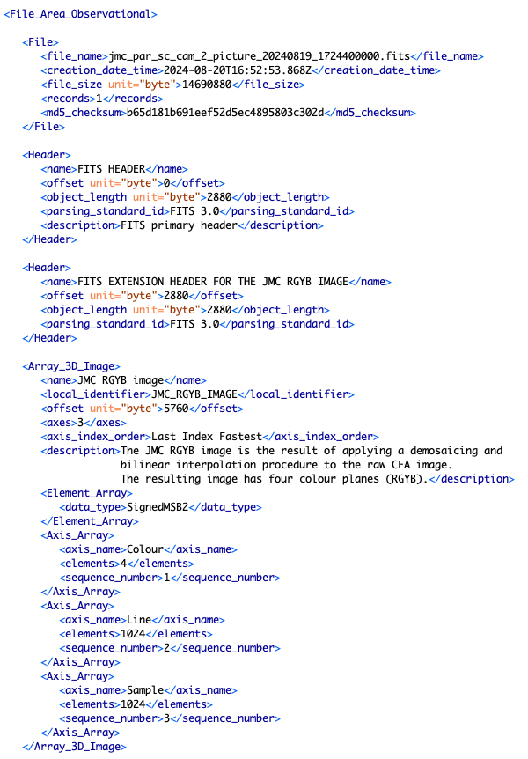
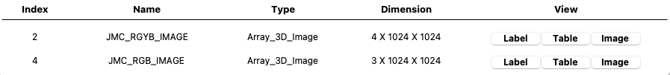
One product does not mean one structure!
Data in a FITS file
(more on this later today)
The file has human readable FITS headers
Header parsable structure
object_length
offset
parsing_standard_id: FITS 3.0
The data are RGB and RGYB images
The data are in an Array structure
Array_3D_Image classes
Define the element type
Define the number of axes
Define the axis order

Slide 17
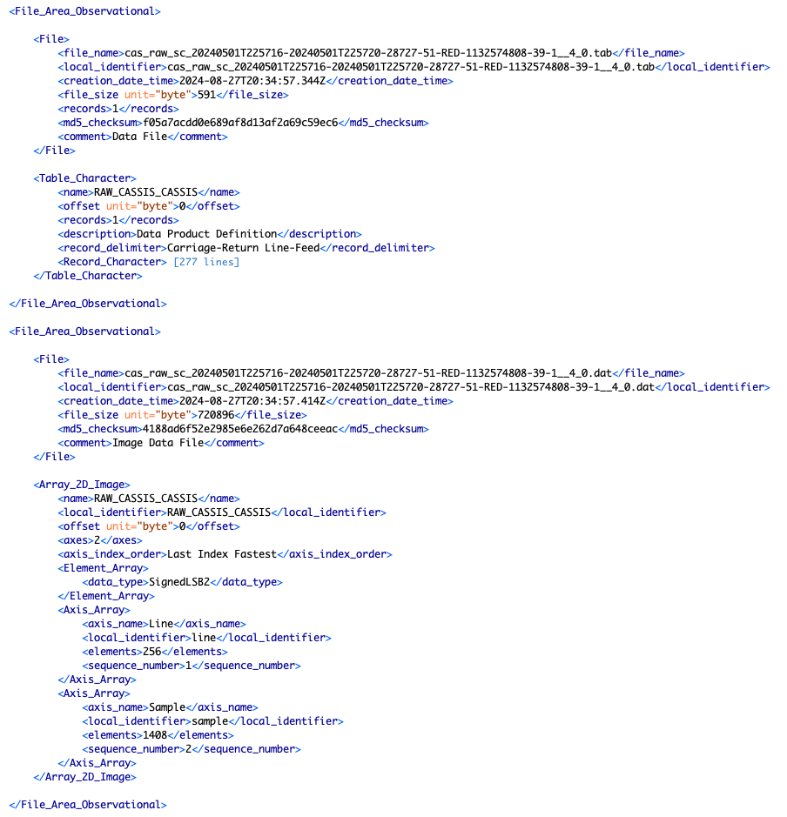
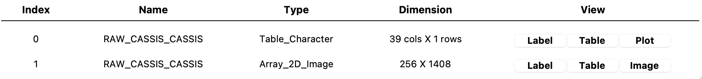
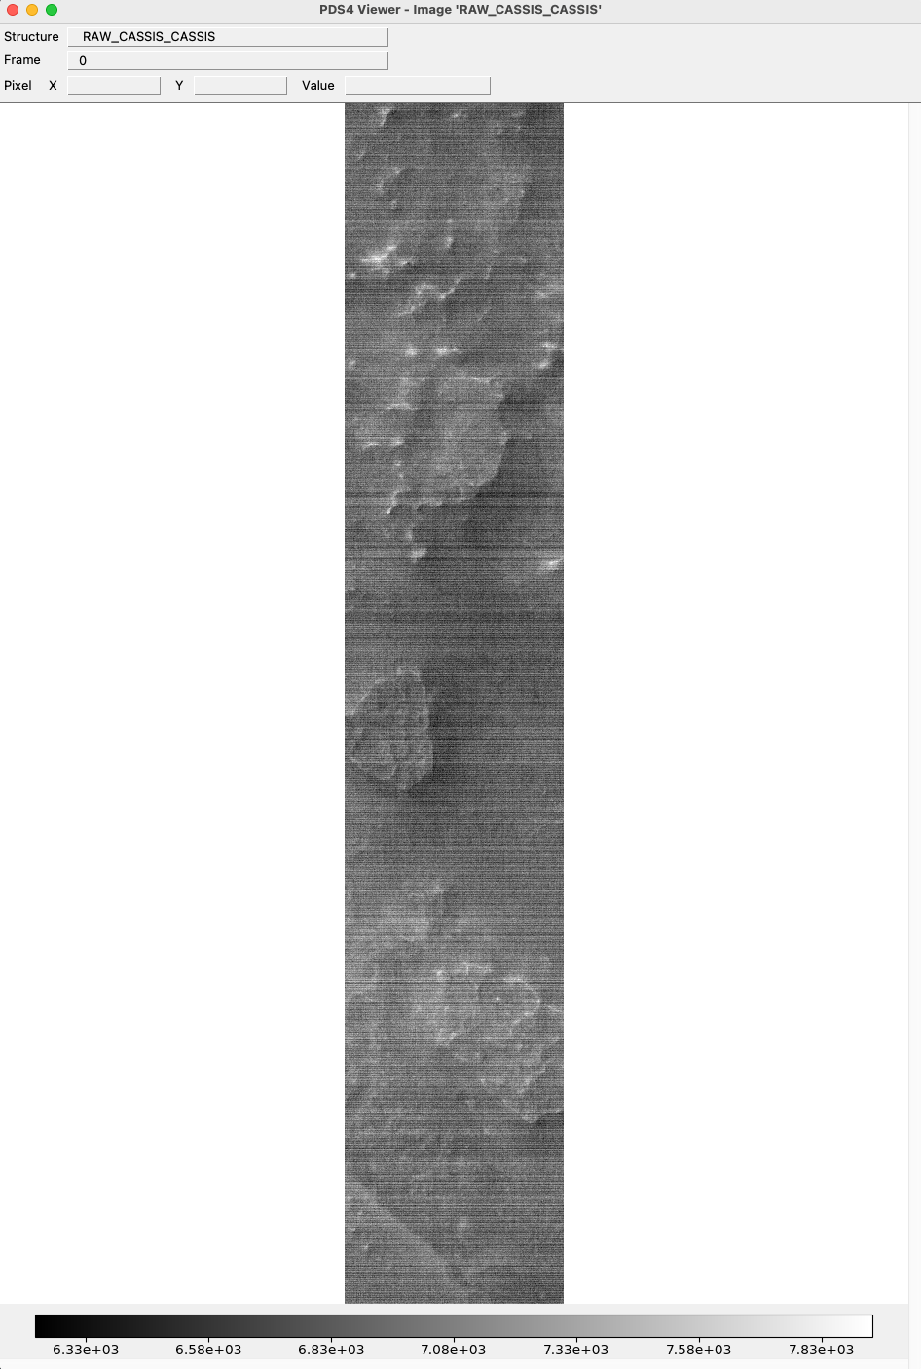
One product does not mean one structure!
Table data are stored in one ASCII file
The product has one fixed-width ASCII table (Table_Character)
→ Define the records and fields structure
Image data are stored in a binary file
The CASSIS image data are stored in a binary array (Array_2D_Image)
→ Define the element type, and axes

Slide 18
Useful resources
PDS4 data provider’s handbook: https://pds.nasa.gov/datastandards/documents/dph/current/PDS4_DataProvidersHandbook_1.22.0.pdf
PDS Standards Reference: https://pds.nasa.gov/datastandards/documents/sr/current/StdRef_1.22.0.pdf
PDS4 Data Dictionary search: https://pds.nasa.gov/datastandards/documents/dd/common/current/
PSA PDS4 Archiving Guide (Chapter 5): https://s2e2.cosmos.esa.int/confluence/display/PSAPUB1/5.+Product+Types
Resources on data types (Character, Binary)
Your friendly Archive Scientist !

